Slide 1


Exposure Java 2013
PreAPCS Edition
Chapter 10
Output Slides
For Teachers
PowerPoint Presentation
created by:
Mr. John L. M. Schram
and Mr. Leon Schram
Authors of Exposure Java

Slide 2
Output Programs
These slides will present a variety of small programs. Each program has some type of array that was introduced in this chapter.
Our concern will be with the output of each program, and more importantly, develop some methods to determine program output correctly, for programs that involves arrays.
You can expect that on quizzes and/or tests only a program segment or a method is shown.

Slide 3

Teacher/Student Versions, Tablet PCs, and Inking
The “For Teachers” version of this presentation has 2 slides for each program.
The first slide only shows the program.
The second shows the program, worked out solution, and output.
The “For Students” version
only has 1 slide for each
program with no provided
solution or output. Students are
expected to work out the solutions either on paper, or ideally they can “ink” directly on their laptops.

Slide 4
public class Ex1201
{
public static void main (String args[])
{
int list[] = {11,99,22,88,33,77,44,66,55};
System.out.println(list[1]);
}
}

Slide 5
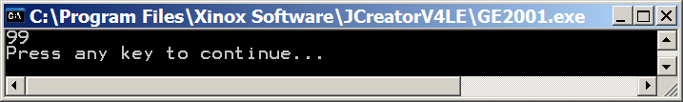
public class Ex1201
{
public static void main (String args[])
{
int list[] = {11,99,22,88,33,77,44,66,55};
System.out.println(list[1]);
}
}
0 | 1 | 2 | 3 | 4 | 5 | 6 | 7 | 8
11 | 99 | 22 | 88 | 33 | 77 | 44 | 66 | 55

Slide 6
public class Ex1202
{
public static void main (String args[])
{
int list[] = {11,99,22,88,33,77,44,66,55};
for (int index = 1; index <= 9; index++)
System.out.println(list[index]);
}
}

Slide 7
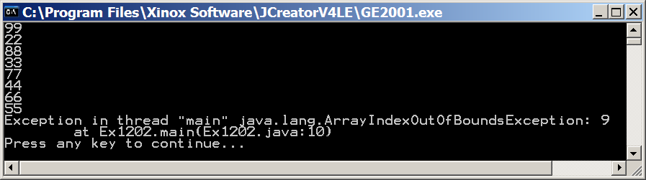
public class Ex1202
{
public static void main (String args[])
{
int list[] = {11,99,22,88,33,77,44,66,55};
for (int index = 1; index <= 9; index++)
System.out.println(list[index]);
}
}
0 | 1 | 2 | 3 | 4 | 5 | 6 | 7 | 8
11 | 99 | 22 | 88 | 33 | 77 | 44 | 66 | 55

Slide 8
public class Ex1203
{
public static void main (String args[])
{
int list[] = {11,99,22,88,33,77,44,66,55};
for (int index = 0; index < 9; index++)
System.out.println(list[index]);
}
}

Slide 9
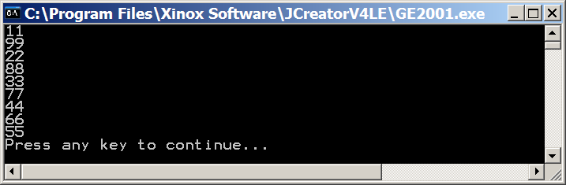
public class Ex1203
{
public static void main (String args[])
{
int list[] = {11,99,22,88,33,77,44,66,55};
for (int index = 0; index < 9; index++)
System.out.println(list[index]);
}
}
0 | 1 | 2 | 3 | 4 | 5 | 6 | 7 | 8
11 | 99 | 22 | 88 | 33 | 77 | 44 | 66 | 55

Slide 10
public class Ex1204
{
public static void main (String args[])
{
int list[] = {11,99,22,88,33,77,44,66,55};
displayArray(list);
}
public static void displayArray(int array[])
{
// Precondition: array is a non-empty Java static array of integers
System.out.print("[" + array[0]);
for (int index = 1; index < array.length; index++)
System.out.print(", " + array[index]);
System.out.println("]");
}
}

Slide 11
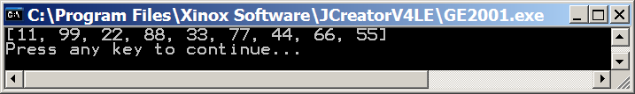
public class Ex1204
{
public static void main (String args[])
{
int list[] = {11,99,22,88,33,77,44,66,55};
displayArray(list);
}
public static void displayArray(int array[])
{
// Precondition: array is a non-empty Java static array of integers
System.out.print("[" + array[0]);
for (int index = 1; index < array.length; index++)
System.out.print(", " + array[index]);
System.out.println("]");
}
}
0 | 1 | 2 | 3 | 4 | 5 | 6 | 7 | 8
11 | 99 | 22 | 88 | 33 | 77 | 44 | 66 | 55

Slide 12
public class Ex1205
{
public static void main (String args[])
{
int list[] = new int[10];
displayArray(list);
}
public static void displayArray(int array[])
{
// Precondition: array is a non-empty Java static array of integers
System.out.print("[" + array[0]);
for (int index = 1; index < array.length; index++)
System.out.print(", " + array[index]);
System.out.println("]");
}
}

Slide 13
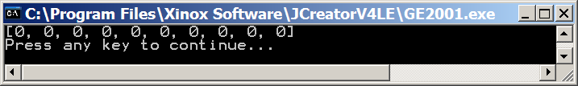
public class Ex1205
{
public static void main (String args[])
{
int list[] = new int[10];
displayArray(list);
}
public static void displayArray(int array[])
{
// Precondition: array is a non-empty Java static array of integers
System.out.print("[" + array[0]);
for (int index = 1; index < array.length; index++)
System.out.print(", " + array[index]);
System.out.println("]");
}
}
0 | 1 | 2 | 3 | 4 | 5 | 6 | 7 | 8 | 9
0 | 0 | 0 | 0 | 0 | 0 | 0 | 0 | 0 | 0
new int Arrays
are automatically
initialized to 0.

Slide 14
public class Ex1206
{
public static void main (String args[])
{
int list[] = new int[10];
list[0] = 9999;
displayArray(list);
}
public static void displayArray(int array[])
{
// Precondition: array is a non-empty Java static array of integers
System.out.print("[" + array[0]);
for (int index = 1; index < array.length; index++)
System.out.print(", " + array[index]);
System.out.println("]");
}
}

Slide 15
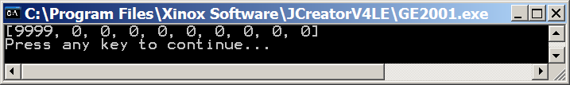
public class Ex1206
{
public static void main (String args[])
{
int list[] = new int[10];
list[0] = 9999;
displayArray(list);
}
public static void displayArray(int array[])
{
// Precondition: array is a non-empty Java static array of integers
System.out.print("[" + array[0]);
for (int index = 1; index < array.length; index++)
System.out.print(", " + array[index]);
System.out.println("]");
}
}
0 | 1 | 2 | 3 | 4 | 5 | 6 | 7 | 8 | 9
0 | 0 | 0 | 0 | 0 | 0 | 0 | 0 | 0 | 0
9999 | 0 | 0 | 0 | 0 | 0 | 0 | 0 | 0 | 0

Slide 16
public class Ex1207
{
public static void main (String args[])
{
int list[] = new int[10];
list[1] = list[3] = list[5] = list[7] = list[9] = 9999;
displayArray(list);
}
public static void displayArray(int array[])
{
// Precondition: array is a non-empty Java static array of integers
System.out.print("[" + array[0]);
for (int index = 1; index < array.length; index++)
System.out.print(", " + array[index]);
System.out.println("]");
}
}

Slide 17
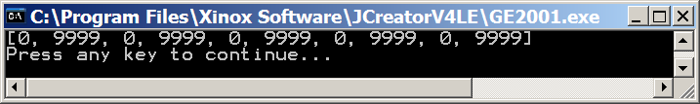
public class Ex1207
{
public static void main (String args[])
{
int list[] = new int[10];
list[1] = list[3] = list[5] = list[7] = list[9] = 9999;
displayArray(list);
}
public static void displayArray(int array[])
{
// Precondition: array is a non-empty Java static array of integers
System.out.print("[" + array[0]);
for (int index = 1; index < array.length; index++)
System.out.print(", " + array[index]);
System.out.println("]");
}
}
0 | 1 | 2 | 3 | 4 | 5 | 6 | 7 | 8 | 9
0 | 0 | 0 | 0 | 0 | 0 | 0 | 0 | 0 | 0
0 | 9999 | 0 | 9999 | 0 | 9999 | 0 | 9999 | 0 | 9999

Slide 18
public class Ex1208
{
public static void main (String args[])
{
int list[] = {11,99,22,88,33,77,44,66,55};
list[1] = list[3] = list[5] = list[7] = list[9] = 9999;
displayArray(list);
}
public static void displayArray(int array[])
{
// Precondition: array is a non-empty Java static array of integers
System.out.print("[" + array[0]);
for (int index = 1; index < array.length; index++)
System.out.print(", " + array[index]);
System.out.println("]");
}
}

Slide 19
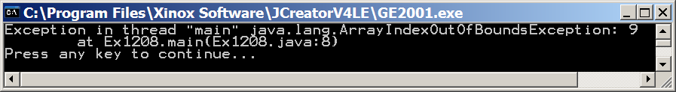
public class Ex1208
{
public static void main (String args[])
{
int list[] = {11,99,22,88,33,77,44,66,55};
list[1] = list[3] = list[5] = list[7] = list[9] = 9999;
displayArray(list);
}
public static void displayArray(int array[])
{
// Precondition: array is a non-empty Java static array of integers
System.out.print("[" + array[0]);
for (int index = 1; index < array.length; index++)
System.out.print(", " + array[index]);
System.out.println("]");
}
}
0 | 1 | 2 | 3 | 4 | 5 | 6 | 7 | 8
11 | 99 | 22 | 88 | 33 | 77 | 44 | 66 | 55
11 | 9999 | 22 | 9999 | 33 | 9999 | 44 | 9999 | 55 | 9999

Slide 20
public class Ex1209
{
public static void main (String args[])
{
int list[] = {11,99,22,88,33,77,44,66,55};
list[1] = list[3] = list[5] = list[7] = 9999;
displayArray(list);
}
public static void displayArray(int array[])
{
// Precondition: array is a non-empty Java static array of integers
System.out.print("[" + array[0]);
for (int index = 1; index < array.length; index++)
System.out.print(", " + array[index]);
System.out.println("]");
}
}

Slide 21
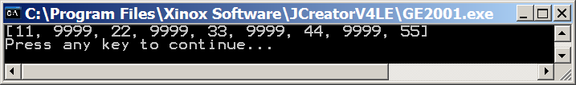
public class Ex1209
{
public static void main (String args[])
{
int list[] = {11,99,22,88,33,77,44,66,55};
list[1] = list[3] = list[5] = list[7] = 9999;
displayArray(list);
}
public static void displayArray(int array[])
{
// Precondition: array is a non-empty Java static array of integers
System.out.print("[" + array[0]);
for (int index = 1; index < array.length; index++)
System.out.print(", " + array[index]);
System.out.println("]");
}
}
0 | 1 | 2 | 3 | 4 | 5 | 6 | 7 | 8
11 | 99 | 22 | 88 | 33 | 77 | 44 | 66 | 55
11 | 9999 | 22 | 9999 | 33 | 9999 | 44 | 9999 | 55

Slide 22
public class Ex1210
{
public static void main (String args[])
{
int list[] = {11,99,22,88,33,77,44,66,55};
list[1] = list[3];
list[5] = list[7];
list[8] = list[6];
list[2] = list[0];
displayArray(list);
}
public static void displayArray(int array[])
{
// Precondition: array is a non-empty Java static array of integers
System.out.print("[" + array[0]);
for (int index = 1; index < array.length; index++)
System.out.print(", " + array[index]);
System.out.println("]");
}
}

Slide 23
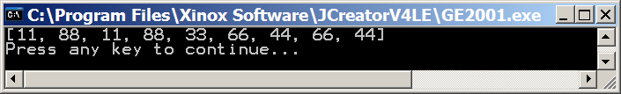
public class Ex1210
{
public static void main (String args[])
{
int list[] = {11,99,22,88,33,77,44,66,55};
list[1] = list[3];
list[5] = list[7];
list[8] = list[6];
list[2] = list[0];
displayArray(list);
}
public static void displayArray(int array[])
{
// Precondition: array is a non-empty Java static array of integers
System.out.print("[" + array[0]);
for (int index = 1; index < array.length; index++)
System.out.print(", " + array[index]);
System.out.println("]");
}
}
0 | 1 | 2 | 3 | 4 | 5 | 6 | 7 | 8
11 | 99 | 22 | 88 | 33 | 77 | 44 | 66 | 55
11 | 88 | 22 | 88 | 33 | 77 | 44 | 66 | 55
11 | 88 | 22 | 88 | 33 | 66 | 44 | 66 | 55
11 | 88 | 22 | 88 | 33 | 66 | 44 | 66 | 44
11 | 88 | 11 | 88 | 33 | 66 | 44 | 66 | 44

Slide 24
public class Ex1211
{
static int list[] = {11,99,22,88,33,77,44,66,55};
public static void main (String args[])
{
swap(3,1);
swap(7,5);
swap(6,8);
swap(0,2);
displayArray();
}
public static void swap(int a, int b)
{
list[a] = list[b];
list[b] = list[a];
}
public static void displayArray()
{
// Precondition: list is a non-empty Java static array of integers
System.out.print("[" + list[0]);
for (int index = 1; index < list.length; index++)
System.out.print(", " + list[index]);
System.out.println("]");
}
}

Slide 25
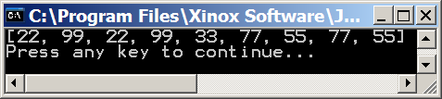
public class Ex1211
{
static int list[] = {11,99,22,88,33,77,44,66,55};
public static void main (String args[])
{
swap(3,1);
swap(7,5);
swap(6,8);
swap(0,2);
displayArray();
}
public static void swap(int a, int b)
{
list[a] = list[b];
list[b] = list[a];
}
public static void displayArray()
{
// Precondition: list is a non-empty Java static array of integers
System.out.print("[" + list[0]);
for (int index = 1; index < list.length; index++)
System.out.print(", " + list[index]);
System.out.println("]");
}
}
0 | 1 | 2 | 3 | 4 | 5 | 6 | 7 | 8
11 | 99 | 22 | 88 | 33 | 77 | 44 | 66 | 55
11 | 99 | 22 | 99 | 33 | 77 | 44 | 66 | 55
11 | 99 | 22 | 99 | 33 | 77 | 44 | 77 | 55
11 | 99 | 22 | 99 | 33 | 77 | 55 | 77 | 55
22 | 99 | 22 | 99 | 33 | 77 | 55 | 77 | 55

Slide 26
public class Ex1212
{
static int list[] = {11,99,22,88,33,77,44,66,55};
public static void main (String args[])
{
swap(3,1);
swap(7,5);
swap(6,8);
swap(0,2);
displayArray();
}
public static void swap(int a, int b)
{
int temp = list[a];
list[a] = list[b];
list[b] = temp;
}
public static void displayArray()
{
// Precondition: list is a non-empty Java static array of integers
System.out.print("[" + list[0]);
for (int index = 1; index < list.length; index++)
System.out.print(", " + list[index]);
System.out.println("]");
}
}

Slide 27
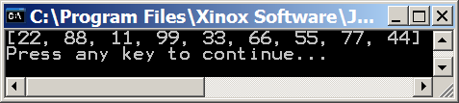
public class Ex1212
{
static int list[] = {11,99,22,88,33,77,44,66,55};
public static void main (String args[])
{
swap(3,1);
swap(7,5);
swap(6,8);
swap(0,2);
displayArray();
}
public static void swap(int a, int b)
{
int temp = list[a];
list[a] = list[b];
list[b] = temp;
}
public static void displayArray()
{
// Precondition: list is a non-empty Java static array of integers
System.out.print("[" + list[0]);
for (int index = 1; index < list.length; index++)
System.out.print(", " + list[index]);
System.out.println("]");
}
}
0 | 1 | 2 | 3 | 4 | 5 | 6 | 7 | 8
11 | 99 | 22 | 88 | 33 | 77 | 44 | 66 | 55
11 | 88 | 22 | 99 | 33 | 77 | 44 | 66 | 55
11 | 88 | 22 | 99 | 33 | 66 | 44 | 77 | 55
11 | 88 | 22 | 99 | 33 | 66 | 55 | 77 | 44
22 | 88 | 11 | 99 | 33 | 66 | 55 | 77 | 44

Slide 28
public class Ex1213
{
public static void main (String args[])
{
int list[] = new int[10];
qwerty(list,5);
displayArray(list);
}
public static void qwerty(int array[], int item)
{
for (int index = 0; index < array.length; index++)
array[index] = item;
}
public static void displayArray(int array[])
{
// Precondition: array is a non-empty Java static array of integers
System.out.print("[" + array[0]);
for (int index = 1; index < array.length; index++)
System.out.print(", " + array[index]);
System.out.println("]");
}
}

Slide 29
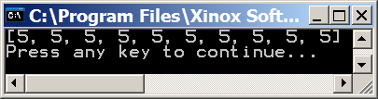
public class Ex1213
{
public static void main (String args[])
{
int list[] = new int[10];
qwerty(list,5);
displayArray(list);
}
public static void qwerty(int array[], int item)
{
for (int index = 0; index < array.length; index++)
array[index] = item;
}
public static void displayArray(int array[])
{
// Precondition: array is a non-empty Java static array of integers
System.out.print("[" + array[0]);
for (int index = 1; index < array.length; index++)
System.out.print(", " + array[index]);
System.out.println("]");
}
}
0 | 1 | 2 | 3 | 4 | 5 | 6 | 7 | 8 | 9
0 | 0 | 0 | 0 | 0 | 0 | 0 | 0 | 0 | 0
5 | 5 | 5 | 5 | 5 | 5 | 5 | 5 | 5 | 5

Slide 30
public class Ex1214
{
public static void main (String args[])
{
int list[] = {11,99,22,88,33,77,44,66,55};
qwerty(list,5);
displayArray(list);
}
public static void qwerty(int array[], int item)
{
for (int index = 0; index < array.length; index++)
array[index] = item;
}
public static void displayArray(int array[])
{
// Precondition: array is a non-empty Java static array of integers
System.out.print("[" + array[0]);
for (int index = 1; index < array.length; index++)
System.out.print(", " + array[index]);
System.out.println("]");
}
}

Slide 31
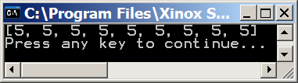
public class Ex1214
{
public static void main (String args[])
{
int list[] = {11,99,22,88,33,77,44,66,55};
qwerty(list,5);
displayArray(list);
}
public static void qwerty(int array[], int item)
{
for (int index = 0; index < array.length; index++)
array[index] = item;
}
public static void displayArray(int array[])
{
// Precondition: array is a non-empty Java static array of integers
System.out.print("[" + array[0]);
for (int index = 1; index < array.length; index++)
System.out.print(", " + array[index]);
System.out.println("]");
}
}
0 | 1 | 2 | 3 | 4 | 5 | 6 | 7 | 8
11 | 99 | 22 | 88 | 33 | 77 | 44 | 66 | 55
5 | 5 | 5 | 5 | 5 | 5 | 5 | 5 | 5

Slide 32
public class Ex1215
{
public static void main (String args[])
{
int list[] = {11,99,22,88,33,77,44,66,55};
qwerty(list,5);
list[5] = 9999;
displayArray(list);
}
public static void qwerty(int array[], int item)
{
for (int index = 0; index < array.length; index++)
array[index] = item;
}
public static void displayArray(int array[])
{
// Precondition: array is a non-empty Java static array of integers
System.out.print("[" + array[0]);
for (int index = 1; index < array.length; index++)
System.out.print(", " + array[index]);
System.out.println("]");
}
}

Slide 33
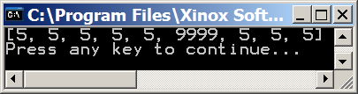
public class Ex1215
{
public static void main (String args[])
{
int list[] = {11,99,22,88,33,77,44,66,55};
qwerty(list,5);
list[5] = 9999;
displayArray(list);
}
public static void qwerty(int array[], int item)
{
for (int index = 0; index < array.length; index++)
array[index] = item;
}
public static void displayArray(int array[])
{
// Precondition: array is a non-empty Java static array of integers
System.out.print("[" + array[0]);
for (int index = 1; index < array.length; index++)
System.out.print(", " + array[index]);
System.out.println("]");
}
}
0 | 1 | 2 | 3 | 4 | 5 | 6 | 7 | 8
11 | 99 | 22 | 88 | 33 | 77 | 44 | 66 | 55
5 | 5 | 5 | 5 | 5 | 5 | 5 | 5 | 5
5 | 5 | 5 | 5 | 5 | 9999 | 5 | 5 | 5

Slide 34
public class Ex1216
{
public static void main (String args[])
{
int list[] = {11,99,22,88,33,77,44,66,55};
list[1] = list[2] + list[0];
list[8] = list[7] + list[6];
list[5] = list[8] - list[1];
displayArray(list);
}
public static void displayArray(int array[])
{
// Precondition: array is a non-empty Java static array of integers
System.out.print("[" + array[0]);
for (int index = 1; index < array.length; index++)
System.out.print(", " + array[index]);
System.out.println("]");
}
}

Slide 35
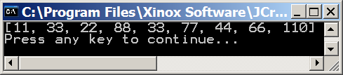
public class Ex1216
{
public static void main (String args[])
{
int list[] = {11,99,22,88,33,77,44,66,55};
list[1] = list[2] + list[0];
list[8] = list[7] + list[6];
list[5] = list[8] - list[1];
displayArray(list);
}
public static void displayArray(int array[])
{
// Precondition: array is a non-empty Java static array of integers
System.out.print("[" + array[0]);
for (int index = 1; index < array.length; index++)
System.out.print(", " + array[index]);
System.out.println("]");
}
}
0 | 1 | 2 | 3 | 4 | 5 | 6 | 7 | 8
11 | 99 | 22 | 88 | 33 | 77 | 44 | 66 | 55
11 | 33 | 22 | 88 | 33 | 77 | 44 | 66 | 55
11 | 33 | 22 | 88 | 33 | 77 | 44 | 66 | 110
11 | 33 | 22 | 88 | 33 | 77 | 44 | 66 | 110

Slide 36
public class Ex1217
{
public static void main (String args[])
{
int list1[] = {11,99,22,88,33,77,44,66,55};
int list2[] = new int[100];
System.out.println(list1.length);
System.out.println(list2.length);
}
}

Slide 37
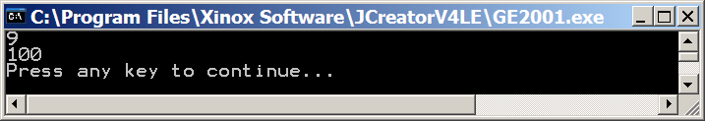
public class Ex1217
{
public static void main (String args[])
{
int list1[] = {11,99,22,88,33,77,44,66,55};
int list2[] = new int[100];
System.out.println(list1.length);
System.out.println(list2.length);
}
}

Slide 38
public class Ex1218
{
public static void main (String args[])
{
int list[] = {11,99,22,88,33,77,44,66,55};
for(int index = 0; index < list.length; index++)
list[index]++;
displayArray(list);
}
public static void displayArray(int array[])
{
// Precondition: array is a non-empty Java static array of integers
System.out.print("[" + array[0]);
for (int index = 1; index < array.length; index++)
System.out.print(", " + array[index]);
System.out.println("]");
}
}

Slide 39

public class Ex1218
{
public static void main (String args[])
{
int list[] = {11,99,22,88,33,77,44,66,55};
for(int index = 0; index < list.length; index++)
list[index]++;
displayArray(list);
}
public static void displayArray(int array[])
{
// Precondition: array is a non-empty Java static array of integers
System.out.print("[" + array[0]);
for (int index = 1; index < array.length; index++)
System.out.print(", " + array[index]);
System.out.println("]");
}
}
0 | 1 | 2 | 3 | 4 | 5 | 6 | 7 | 8
11 | 99 | 22 | 88 | 33 | 77 | 44 | 66 | 55
12 | 100 | 23 | 89 | 34 | 78 | 45 | 67 | 56

Slide 40
public class Ex1219
{
public static void main (String args[])
{
int list[] = {11,99,22,88,33,77,44,66,55};
list[1] = list[2] + list[0];
int x = 1;
if (list[1] == list[4])
x = 11;
for(int index = 0; index < list.length; index++)
list[index] /= x;
displayArray(list);
}
public static void displayArray(int array[])
{
// Precondition: array is a non-empty Java static array of integers
System.out.print("[" + array[0]);
for (int index = 1; index < array.length; index++)
System.out.print(", " + array[index]);
System.out.println("]");
}
}

Slide 41
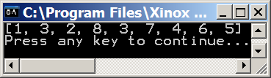
public class Ex1219
{
public static void main (String args[])
{
int list[] = {11,99,22,88,33,77,44,66,55};
list[1] = list[2] + list[0];
int x = 1;
if (list[1] == list[4])
x = 11;
for(int index = 0; index < list.length; index++)
list[index] /= x;
displayArray(list);
}
public static void displayArray(int array[])
{
// Precondition: array is a non-empty Java static array of integers
System.out.print("[" + array[0]);
for (int index = 1; index < array.length; index++)
System.out.print(", " + array[index]);
System.out.println("]");
}
}
0 | 1 | 2 | 3 | 4 | 5 | 6 | 7 | 8
11 | 99 | 22 | 88 | 33 | 77 | 44 | 66 | 55
11 | 33 | 22 | 88 | 33 | 77 | 44 | 66 | 55
1 | 3 | 2 | 8 | 3 | 7 | 4 | 6 | 5
x
1
11

Slide 42
public class Ex1220
{
public static void main (String args[])
{
int list[] = {11,99,22,88,33,77,44,66,55};
System.out.println(list[list.length]);
}
}

Slide 43

public class Ex1220
{
public static void main (String args[])
{
int list[] = {11,99,22,88,33,77,44,66,55};
System.out.println(list[list.length]);
}
}

Slide 44
public class Ex1221
{
public static void main (String args[])
{
int list[] = {11,99,22,88,33,77,44,66,55};
System.out.println(list[list.length - 1]);
}
}

Slide 45
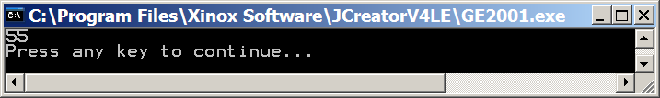
public class Ex1221
{
public static void main (String args[])
{
int list[] = {11,99,22,88,33,77,44,66,55};
System.out.println(list[list.length - 1]);
}
}
0 | 1 | 2 | 3 | 4 | 5 | 6 | 7 | 8
11 | 99 | 22 | 88 | 33 | 77 | 44 | 66 | 55

Slide 46
import java.text.DecimalFormat;
public class Ex1222
{
public static void main (String args[])
{
int matrix[][] = new int[8][5];
init2DArray(matrix);
display2DArray(matrix);
}
public static void init2DArray(int mat[][])
{
for(int row = 0; row < mat.length; row++)
for(int col = 0; col < mat[row].length; col++)
mat[row][col] = row;
}
public static void display2DArray(int mat[][])
{
DecimalFormat twoDigits = new DecimalFormat("00");
for(int row = 0; row < mat.length; row++)
{
for(int col = 0; col < mat[row].length; col++)
System.out.print(twoDigits.format(mat[row][col]) + " ");
System.out.println();
}
}
}

Slide 47
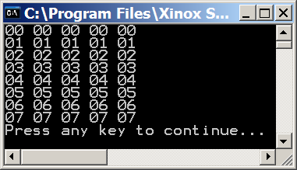
import java.text.DecimalFormat;
public class Ex1222
{
public static void main (String args[])
{
int matrix[][] = new int[8][5];
init2DArray(matrix);
display2DArray(matrix);
}
public static void init2DArray(int mat[][])
{
for(int row = 0; row < mat.length; row++)
for(int col = 0; col < mat[row].length; col++)
mat[row][col] = row;
}
public static void display2DArray(int mat[][])
{
DecimalFormat twoDigits = new DecimalFormat("00");
for(int row = 0; row < mat.length; row++)
{
for(int col = 0; col < mat[row].length; col++)
System.out.print(twoDigits.format(mat[row][col]) + " ");
System.out.println();
}
}
}

Slide 48
import java.text.DecimalFormat;
public class Ex1223
{
public static void main (String args[])
{
int matrix[][] = new int[10][15];
init2DArray(matrix);
display2DArray(matrix);
}
public static void init2DArray(int mat[][])
{
for(int row = 0; row < mat.length; row++)
for(int col = 0; col < mat[row].length; col++)
mat[row][col] = col;
}
public static void display2DArray(int mat[][])
{
DecimalFormat twoDigits = new DecimalFormat("00");
for(int row = 0; row < mat.length; row++)
{
for(int col = 0; col < mat[row].length; col++)
System.out.print(twoDigits.format(mat[row][col]) + " ");
System.out.println();
}
}
}

Slide 49
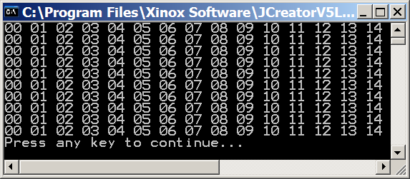
import java.text.DecimalFormat;
public class Ex1223
{
public static void main (String args[])
{
int matrix[][] = new int[10][15];
init2DArray(matrix);
display2DArray(matrix);
}
public static void init2DArray(int mat[][])
{
for(int row = 0; row < mat.length; row++)
for(int col = 0; col < mat[row].length; col++)
mat[row][col] = col;
}
public static void display2DArray(int mat[][])
{
DecimalFormat twoDigits = new DecimalFormat("00");
for(int row = 0; row < mat.length; row++)
{
for(int col = 0; col < mat[row].length; col++)
System.out.print(twoDigits.format(mat[row][col]) + " ");
System.out.println();
}
}
}

Slide 50
import java.text.DecimalFormat;
public class Ex1224
{
public static void main (String args[])
{
int matrix[][] = new int[7][7];
init2DArray(matrix);
display2DArray(matrix);
}
public static void init2DArray(int mat[][])
{
for(int row = 0; row < mat.length; row++)
for(int col = 0; col < mat[row].length; col++)
mat[row][col] = row + col;
}
public static void display2DArray(int mat[][])
{
DecimalFormat twoDigits = new DecimalFormat("00");
for(int row = 0; row < mat.length; row++)
{
for(int col = 0; col < mat[row].length; col++)
System.out.print(twoDigits.format(mat[row][col]) + " ");
System.out.println();
}
}
}

Slide 51
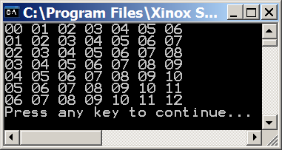
import java.text.DecimalFormat;
public class Ex1224
{
public static void main (String args[])
{
int matrix[][] = new int[7][7];
init2DArray(matrix);
display2DArray(matrix);
}
public static void init2DArray(int mat[][])
{
for(int row = 0; row < mat.length; row++)
for(int col = 0; col < mat[row].length; col++)
mat[row][col] = row + col;
}
public static void display2DArray(int mat[][])
{
DecimalFormat twoDigits = new DecimalFormat("00");
for(int row = 0; row < mat.length; row++)
{
for(int col = 0; col < mat[row].length; col++)
System.out.print(twoDigits.format(mat[row][col]) + " ");
System.out.println();
}
}
}

Slide 52
import java.text.DecimalFormat;
public class Ex1225
{
public static void main (String args[])
{
int matrix[][] = new int[10][15];
init2DArray(matrix);
display2DArray(matrix);
}
public static void init2DArray(int mat[][])
{
for(int row = 0; row < mat.length; row++)
for(int col = 0; col < mat[row].length; col++)
mat[col][row] = 100;
}
public static void display2DArray(int mat[][])
{
DecimalFormat twoDigits = new DecimalFormat("00");
for(int row = 0; row < mat.length; row++)
{
for(int col = 0; col < mat[row].length; col++)
System.out.print(twoDigits.format(mat[row][col]) + " ");
System.out.println();
}
}
}

Slide 53
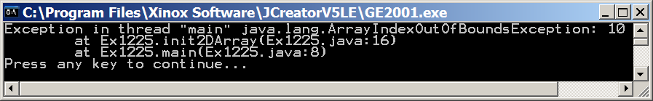
import java.text.DecimalFormat;
public class Ex1225
{
public static void main (String args[])
{
int matrix[][] = new int[10][15];
init2DArray(matrix);
display2DArray(matrix);
}
public static void init2DArray(int mat[][])
{
for(int row = 0; row < mat.length; row++)
for(int col = 0; col < mat[row].length; col++)
mat[col][row] = 100;
}
public static void display2DArray(int mat[][])
{
DecimalFormat twoDigits = new DecimalFormat("00");
for(int row = 0; row < mat.length; row++)
{
for(int col = 0; col < mat[row].length; col++)
System.out.print(twoDigits.format(mat[row][col]) + " ");
System.out.println();
}
}
}
The program crashes because the row and column index are backwards. Since there more columns than rows this causes a problem.

Slide 54
import java.text.DecimalFormat;
public class Ex1226
{
public static void main (String args[])
{
int matrix[][] = { {17,24, 1, 8,15},
{23, 5, 7,14,16},
{ 4, 6,13,20,22},
{10,12,19,21, 3},
{11,18,25, 2, 9} };
change2DArray(matrix);
display2DArray(matrix);
}
public static void change2DArray(int mat[][])
{
for(int row = 0; row < mat.length; row++)
for(int col = 0; col < mat[row].length; col++)
mat[row][col]--;
}
public static void display2DArray(int mat[][])
{
DecimalFormat twoDigits = new DecimalFormat("00");
for(int row = 0; row < mat.length; row++)
{
for(int col = 0; col < mat[row].length; col++)
System.out.print(twoDigits.format(mat[row][col]) + " ");
System.out.println();
}
}
}

Slide 55
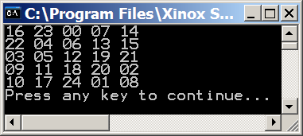
import java.text.DecimalFormat;
public class Ex1226
{
public static void main (String args[])
{
int matrix[][] = { {17,24, 1, 8,15},
{23, 5, 7,14,16},
{ 4, 6,13,20,22},
{10,12,19,21, 3},
{11,18,25, 2, 9} };
change2DArray(matrix);
display2DArray(matrix);
}
public static void change2DArray(int mat[][])
{
for(int row = 0; row < mat.length; row++)
for(int col = 0; col < mat[row].length; col++)
mat[row][col]--;
}
public static void display2DArray(int mat[][])
{
DecimalFormat twoDigits = new DecimalFormat("00");
for(int row = 0; row < mat.length; row++)
{
for(int col = 0; col < mat[row].length; col++)
System.out.print(twoDigits.format(mat[row][col]) + " ");
System.out.println();
}
}
}

Slide 56
import java.text.DecimalFormat;
public class Ex1227
{
public static void main (String args[])
{
int matrix[][] = { {17,24, 1, 8,15},
{23, 5, 7,14,16},
{ 4, 6,13,20,22},
{10,12,19,21, 3},
{11,18,25, 2, 9} };
change2DArray(matrix);
display2DArray(matrix);
}
public static void change2DArray(int mat[][])
{
for(int row = 0; row < mat.length; row++)
for(int col = 1; col < mat[row].length; col++)
mat[row][col] = mat[row][col - 1];
}
public static void display2DArray(int mat[][])
{
DecimalFormat twoDigits = new DecimalFormat("00");
for(int row = 0; row < mat.length; row++)
{
for(int col = 0; col < mat[row].length; col++)
System.out.print(twoDigits.format(mat[row][col]) + " ");
System.out.println();
}
}
}

Slide 57
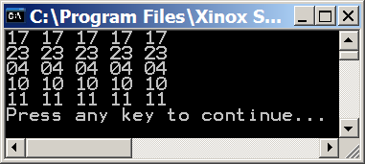
import java.text.DecimalFormat;
public class Ex1227
{
public static void main (String args[])
{
int matrix[][] = { {17,24, 1, 8,15},
{23, 5, 7,14,16},
{ 4, 6,13,20,22},
{10,12,19,21, 3},
{11,18,25, 2, 9} };
change2DArray(matrix);
display2DArray(matrix);
}
public static void change2DArray(int mat[][])
{
for(int row = 0; row < mat.length; row++)
for(int col = 1; col < mat[row].length; col++)
mat[row][col] = mat[row][col - 1];
}
public static void display2DArray(int mat[][])
{
DecimalFormat twoDigits = new DecimalFormat("00");
for(int row = 0; row < mat.length; row++)
{
for(int col = 0; col < mat[row].length; col++)
System.out.print(twoDigits.format(mat[row][col]) + " ");
System.out.println();
}
}
}

Slide 58
import java.text.DecimalFormat;
public class Ex1228
{
public static void main (String args[])
{
int matrix[][] = { {17,24, 1, 8,15},
{23, 5, 7,14,16},
{ 4, 6,13,20,22},
{10,12,19,21, 3},
{11,18,25, 2, 9} };
change2DArray(matrix);
display2DArray(matrix);
}
public static void change2DArray(int mat[][])
{
for(int row = 0; row < mat.length-1; row++)
for(int col = 0; col < mat[row].length; col++)
mat[row][col] = mat[row + 1][col];
}
public static void display2DArray(int mat[][])
{
DecimalFormat twoDigits = new DecimalFormat("00");
for(int row = 0; row < mat.length; row++)
{
for(int col = 0; col < mat[row].length; col++)
System.out.print(twoDigits.format(mat[row][col]) + " ");
System.out.println();
}
}
}

Slide 59
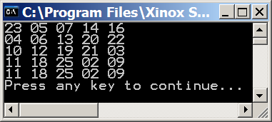
import java.text.DecimalFormat;
public class Ex1228
{
public static void main (String args[])
{
int matrix[][] = { {17,24, 1, 8,15},
{23, 5, 7,14,16},
{ 4, 6,13,20,22},
{10,12,19,21, 3},
{11,18,25, 2, 9} };
change2DArray(matrix);
display2DArray(matrix);
}
public static void change2DArray(int mat[][])
{
for(int row = 0; row < mat.length-1; row++)
for(int col = 0; col < mat[row].length; col++)
mat[row][col] = mat[row + 1][col];
}
public static void display2DArray(int mat[][])
{
DecimalFormat twoDigits = new DecimalFormat("00");
for(int row = 0; row < mat.length; row++)
{
for(int col = 0; col < mat[row].length; col++)
System.out.print(twoDigits.format(mat[row][col]) + " ");
System.out.println();
}
}
}

Slide 60
import java.text.DecimalFormat;
public class Ex1229
{
public static void main (String args[])
{
int matrix[][] = { {17,24, 1, 8,15},
{23, 5, 7,14,16},
{ 4, 6,13,20,22},
{10,12,19,21, 3},
{11,18,25, 2, 9} };
change2DArray(matrix);
display2DArray(matrix);
}
public static void change2DArray(int mat[][])
{
for(int row = 1; row < mat.length-1; row++)
for(int col = 1; col < mat[row].length-1; col++)
mat[row][col] = mat[row + 1][col - 1];
}
public static void display2DArray(int mat[][])
{
DecimalFormat twoDigits = new DecimalFormat("00");
for(int row = 0; row < mat.length; row++)
{
for(int col = 0; col < mat[row].length; col++)
System.out.print(twoDigits.format(mat[row][col]) + " ");
System.out.println();
}
}
}

Slide 61

import java.text.DecimalFormat;
public class Ex1229
{
public static void main (String args[])
{
int matrix[][] = { {17,24, 1, 8,15},
{23, 5, 7,14,16},
{ 4, 6,13,20,22},
{10,12,19,21, 3},
{11,18,25, 2, 9} };
change2DArray(matrix);
display2DArray(matrix);
}
public static void change2DArray(int mat[][])
{
for(int row = 1; row < mat.length-1; row++)
for(int col = 1; col < mat[row].length-1; col++)
mat[row][col] = mat[row + 1][col - 1];
}
public static void display2DArray(int mat[][])
{
DecimalFormat twoDigits = new DecimalFormat("00");
for(int row = 0; row < mat.length; row++)
{
for(int col = 0; col < mat[row].length; col++)
System.out.print(twoDigits.format(mat[row][col]) + " ");
System.out.println();
}
}
}

Slide 62
import java.text.DecimalFormat;
public class Ex1230
{
public static void main (String args[])
{
int matrix[][] = { {17,24, 1, 8,15},
{23, 5, 7,14,16},
{ 4, 6,13,20,22},
{10,12,19,21, 3},
{11,18,25, 2, 9} };
display2DArray(matrix);
change2DArray(matrix);
display2DArray(matrix);
}
public static void change2DArray(int mat[][])
{
int mat2[][] = { { 1, 2, 3, 4},
{ 5, 6, 7, 8},
{ 9,10,11,12},
{13,14,15,16} };
mat = mat2;
display2DArray(mat);
}
public static void display2DArray(int mat[][]) // same as before
}

Slide 63
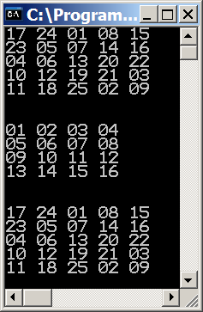
import java.text.DecimalFormat;
public class Ex1230
{
public static void main (String args[])
{
int matrix[][] = { {17,24, 1, 8,15},
{23, 5, 7,14,16},
{ 4, 6,13,20,22},
{10,12,19,21, 3},
{11,18,25, 2, 9} };
display2DArray(matrix);
change2DArray(matrix);
display2DArray(matrix);
}
public static void change2DArray(int mat[][])
{
int mat2[][] = { { 1, 2, 3, 4},
{ 5, 6, 7, 8},
{ 9,10,11,12},
{13,14,15,16} };
mat = mat2;
display2DArray(mat);
}
public static void display2DArray(int mat[][]) // same as before
}

Slide 64
import java.text.DecimalFormat;
public class Ex1231
{
public static void main (String args[])
{
int matrix[][] = { {17,24, 1, 8,15},
{23, 5, 7,14,16},
{ 4, 6,13,20,22},
{10,12,19,21, 3},
{11,18,25, 2, 9} };
display2DArray(matrix);
change2DArray(matrix);
display2DArray(matrix);
}
public static void change2DArray(int mat[][])
{
int mat2[][] = { { 1, 2, 3, 4},
{ 5, 6, 7, 8},
{ 9,10,11,12},
{13,14,15,16} };
for(int row = 0; row < mat.length; row++)
for(int col = 0; col < mat[row].length; col++)
mat[row][col] = mat2[row][col];
display2DArray(mat);
}
public static void display2DArray(int mat[][]) // same as before
}

Slide 65
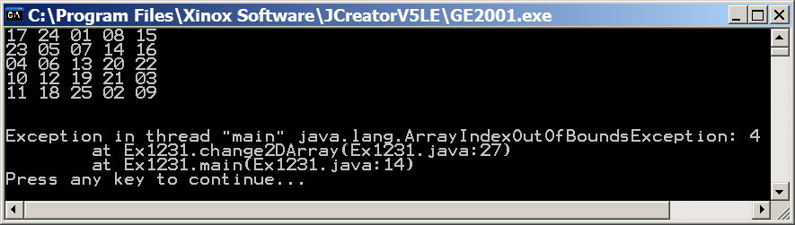
import java.text.DecimalFormat;
public class Ex1231
{
public static void main (String args[])
{
int matrix[][] = { {17,24, 1, 8,15},
{23, 5, 7,14,16},
{ 4, 6,13,20,22},
{10,12,19,21, 3},
{11,18,25, 2, 9} };
display2DArray(matrix);
change2DArray(matrix);
display2DArray(matrix);
}
public static void change2DArray(int mat[][])
{
int mat2[][] = { { 1, 2, 3, 4},
{ 5, 6, 7, 8},
{ 9,10,11,12},
{13,14,15,16} };
for(int row = 0; row < mat.length; row++)
for(int col = 0; col < mat[row].length; col++)
mat[row][col] = mat2[row][col];
display2DArray(mat);
}
public static void display2DArray(int mat[][]) // same as before
}
This would work if the 2 matrixes were the same size. Since the second matrix is smaller we are trying to access rows and columns that do not exist.

Slide 66
import java.text.DecimalFormat;
public class Ex1232
{
public static void main (String args[])
{
int matrix[][] = { {17,24, 1, 8,15},
{23, 5, 7,14,16},
{ 4, 6,13,20,22},
{10,12,19,21, 3},
{11,18,25, 2, 9} };
display2DArray(matrix);
matrix = change2DArray();
display2DArray(matrix);
}
public static int[][] change2DArray()
{
int mat2[][] = { { 1, 2, 3, 4},
{ 5, 6, 7, 8},
{ 9,10,11,12},
{13,14,15,16} };
display2DArray(mat2);
return mat2;
}
public static void display2DArray(int mat[][]) // same as before
}

Slide 67
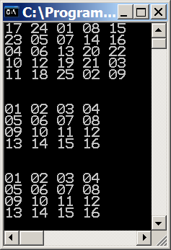
import java.text.DecimalFormat;
public class Ex1232
{
public static void main (String args[])
{
int matrix[][] = { {17,24, 1, 8,15},
{23, 5, 7,14,16},
{ 4, 6,13,20,22},
{10,12,19,21, 3},
{11,18,25, 2, 9} };
display2DArray(matrix);
matrix = change2DArray();
display2DArray(matrix);
}
public static int[][] change2DArray()
{
int mat2[][] = { { 1, 2, 3, 4},
{ 5, 6, 7, 8},
{ 9,10,11,12},
{13,14,15,16} };
display2DArray(mat2);
return mat2;
}
public static void display2DArray(int mat[][]) // same as before
}

